Slide 1
Can AI cause the end of the human race?
Marko Baštovanović
Notes:
I am Marko and I work at Vast as ML software engineer
I create computer vision models to extract features from used cars photos
Got interested in AI Safety on conference just like this one

Slide 2
First things first
The topic is controversial
Care on getting the facts right
You will answer if AI can cause the end of the human race
Notes:
It’s great that coctail party is right after this talk, so we can all drink like it’s the end of the world

Slide 3
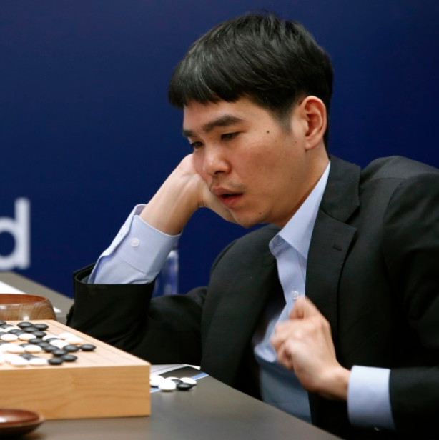
Current state
1997 IBM DeepBlue
2016 AlphaGo
2017 OpenAI DOTA2
Source: Lee Jin-man / AP
Notes:
Knowledge is transferable to real world.
DeepBlue was AI
As soon as AI is reached we start to call it algorithm and not AI

Slide 4

RL is the way to go in AI
Source: Google DeepMind
Notes:
RL is predominant in AI research. Not the usual supervised learning
Breakout
If it’s competitive (Go, DOTA) it plays against a version of itself
What is learned transfers to outside world - e.g. autonomous driving and robots in OpenAI

Slide 5
RL is the way to go in AI
Video removed due to GitHub space limitations. See it at:
https://www.youtube.com/embed/Q70ulPJW3Gk?start=1&end=55
Source: Google DeepMind

Slide 6
After a problem is solved
Source: deepmind.com
Once the human level is reached we soon surpass it by a large margin
Notes:
AlphaGo Zero - 3 days of training to reach AlphaGo Lee Sedol version using 4TPU
AlphaGo had previously played games fed to it
AlphaGo Zero learns everything on its own and achieves better results
Very similar stories across the industry - AlphaGo isn’t an odd example

Slide 7
120 Years of “Moore’s Law”
Notes:
Moore's law is the observation that the number of transistors in a dense integrated circuit doubles about every two years. Progress slowed as we reached 22 nm technology. Actual doubling period is 18 months
Nvidia Volta vs Kepler offers 10x more compute for the same amount of transistors

Slide 8
Predictions about AI
Why we don’t have a base on Moon
Wilbur Wright 1901: “I don't think men will fly for a thousand years”
Watch for: incentives, financials, talent
Notes:
After space race has been won, funding was cut
Only 2 years later, brothers Wright will fly with Wright Flyer

Slide 9
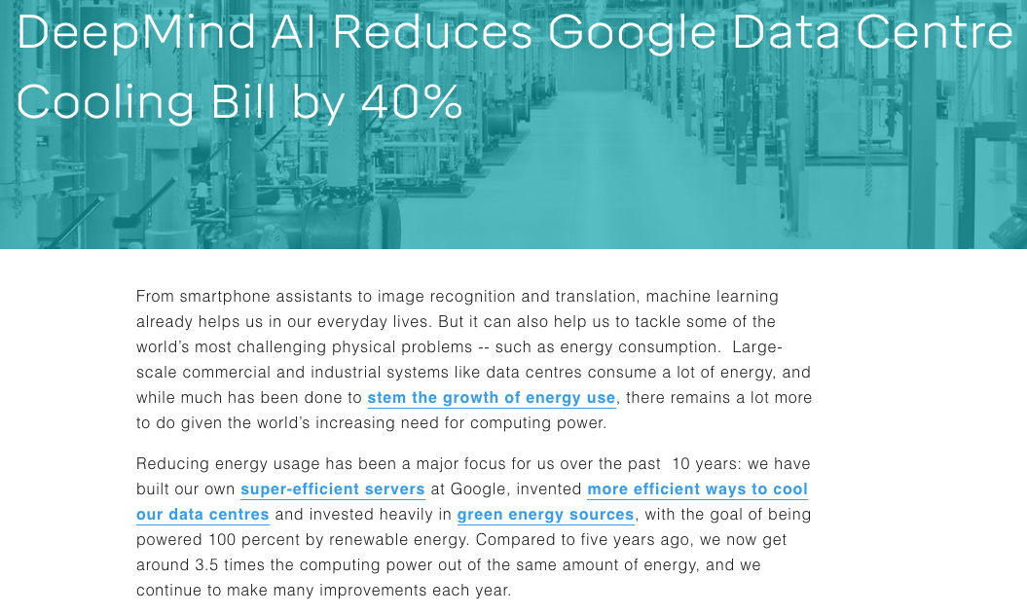
Financial incentives
Source: deepmind.com
Notes:
Headline from 2017
A month ago AI is totally controlling cooling instead of giving recommendations
Google bought DeepMind in 2014 for $500M

Slide 10
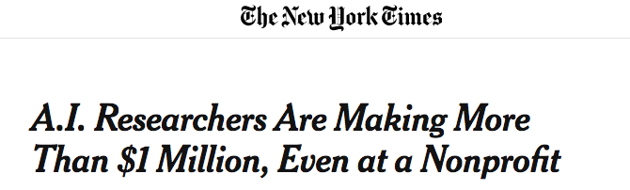
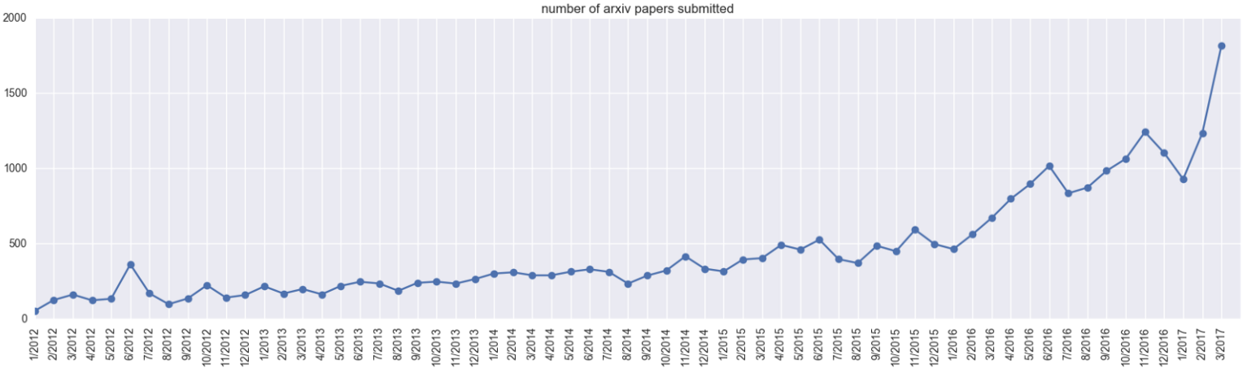
Where does the tallent go
Number of ML/AI arxiv papers submited (2012-2017)
Source: Andrej Karpathy
Notes:
OpenAI paid its top researcher, Ilya Sutskever, more than $1.9 million in 2016.
“Even newly minted Ph.D.s in machine learning and data science can make more than $300,000. “ Bloomberg

Slide 11
The good stuff
Abundance
Make everybody happy
Medicine
Immortality
Colonise other planets
and many more
Source: Dimension Films
Notes:
I am very optimistic and eager to see what the future holds for us, but it's important that we avoid risks so we can live to see the progress
Highlander - Christopher Lambert

Slide 12
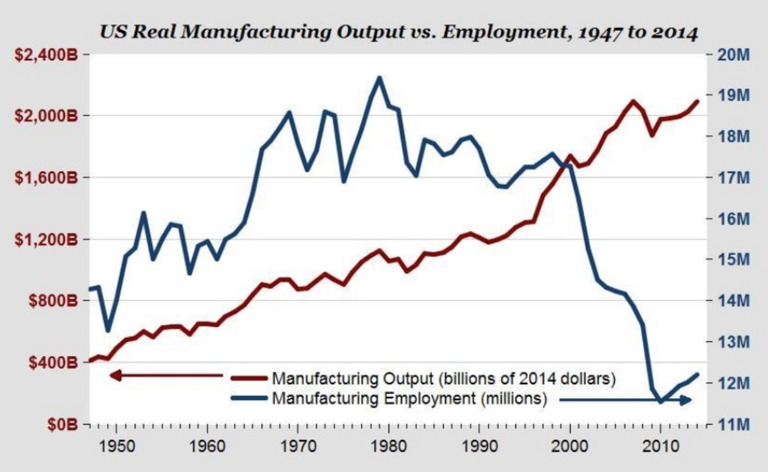
The Bad Stuff: Massive unemployment
Source: Moshe Vardi
Notes:
Would be cool if we can work less and live better off, but it seems that’s not happening

Slide 13
The Bad Stuff:
AI Weaponization
Video removed due to GitHub space limitations. See it at:
https://www.youtube.com/embed/9CO6M2HsoIA?start=15&end=96
Source: Future of Life Institute
Notes:
Scary because technology is there - it’s just matter of a minimisation

Slide 14
Ban Lethal AI Weapons
Source: Max Tegmark
Notes:
If we could do it with bilogical and chemical weapons we can do it with autonomous weapons.

Slide 15
Malicious uses of AI
Spear phishing
Speech, image and video generation
Political instability
Source: Goodfellow et al. (2014)
Notes:
All current technology
Generative adversarial network

Slide 16
Future Progress in AI: A Survey of Expert Opinion
170 AI experts
Superintelligence: 50% by 2040-2050 90% by 2075
1/3 that outcome is “bad” or “extremely bad”
Nick Bostrom
Notes:
Released in 2014. Peer reviewed

Slide 17
AI Alignment
King Midias
Source: Walter Crane
Notes:
Not a real solution: 3 laws of robotics
Similar to real problem: King Midias story
Many researchers are working on this problem and still they don’t think they’ve figured it out.

Slide 18
Don’t panic!
BENEFICIAL AI 2017 conference 23 principles
Signed by: Demis Hassabis, Ilya Sutskever, Yann LeCun, Stuart Russell, Peter Norvig, Ray Kurzweil, Stephen Hawking, Elon Musk, Jaan Tallinn, Sam Altman
Notes:
There are people working on AI Safety - but much more talent goes to development of AI
BENEFICIAL AI 2017 conference picture

Slide 19
But do help if you can
Notes:
There are organizations
There is funding for research
I can introduce you to people from these organisations
PhDs in math, decision theory, CS
Also you can donate. All of these are non-profits

Slide 20
Thank you!
Q & A
Marko Baštovanović
Notes:
Any answer I give will be inferior to “42”
I’ll be happy to answer any questions after the talk
Deep Thought from “The Hitchhiker's Guide to the Galaxy”

